Slide 1

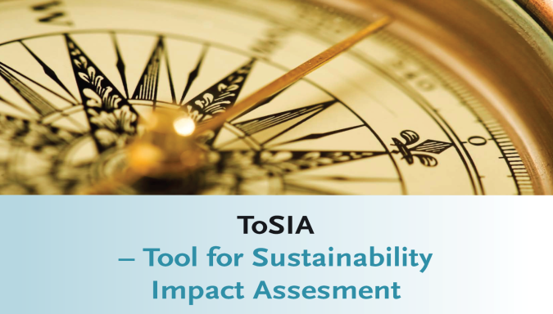

http://tosia.efi.int
Source: fotolia

Slide 2
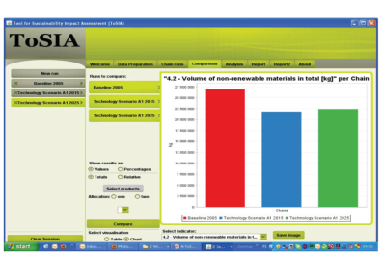
Systematic Sustainability Impact Assessment approach by (To)SIA
ToSIA is a flexible tool, based on three concepts:
Alternative process chains
Material flow along the chain
Indicators per process multiplied with the material flow
ToSIA assesses the sustainability impacts of alternative supply chains.
Source: EFI
Notes:
Background 20 Mio EU project (EFORWOOD) -> NPP project ->
Same criteria apply for qualitative AND for quantitative indicators, therefore: use a proven concept

Slide 3
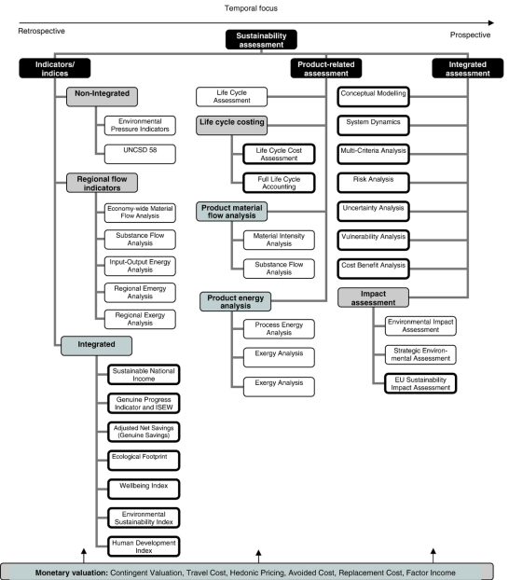
Ness et al. (2007)
Notes:
Different types of approaches that use indicators or similar concepts; however – the purpose of the assessment governs the choice und use of indicators

Slide 4
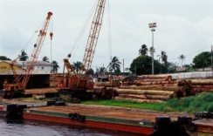

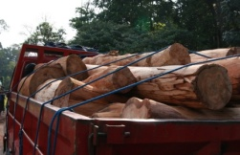
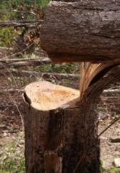
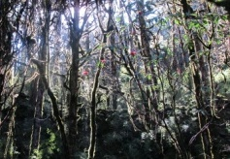
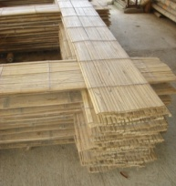
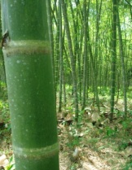
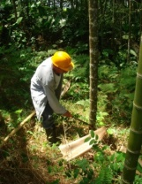
Systematic framework for ex-ante assessments
New landuse structure
Change of material flow
Change of indicator values
Notes:
-> plantation vs. current land use
->
New landuse structure
Changes in Mat flow
Impact areas/changes indicators

Slide 5
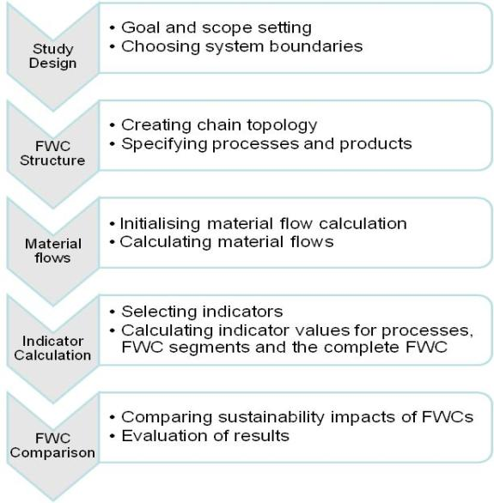
ToSIA workflow

Slide 6
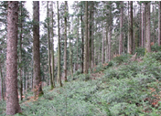
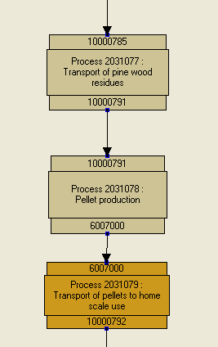

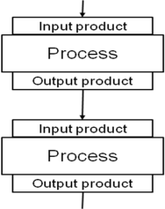

Real world ToSIA data client

Slide 7
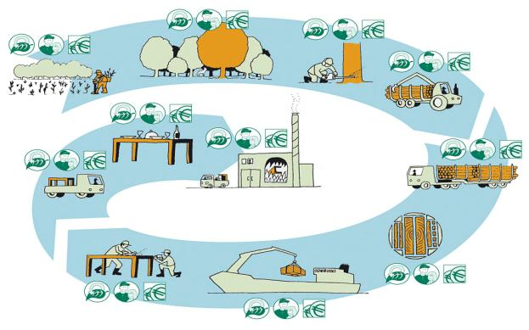
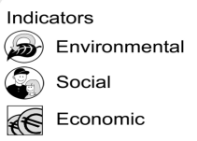
Sustainability indicators linked with FWC processes

Slide 8
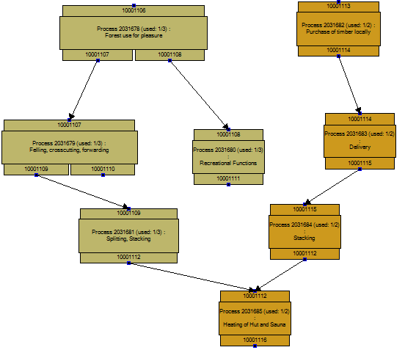
Simple FWC
Self-production or purchase of timber for recreational private use
Notes:
This and the following four slides will be embedded to the previous slide and shown in a quick sequence
KR: fine! Will give a nice idea of the complexity

Slide 9
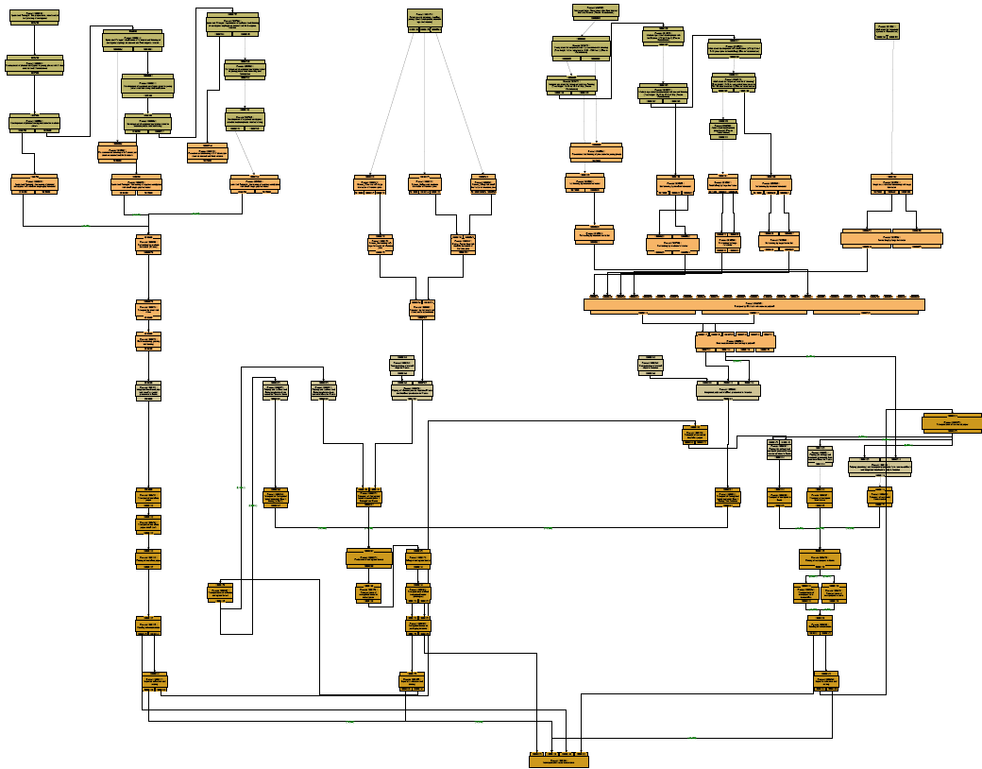
Case study IBERIA:
Pulp and paper consumption driven

Slide 10
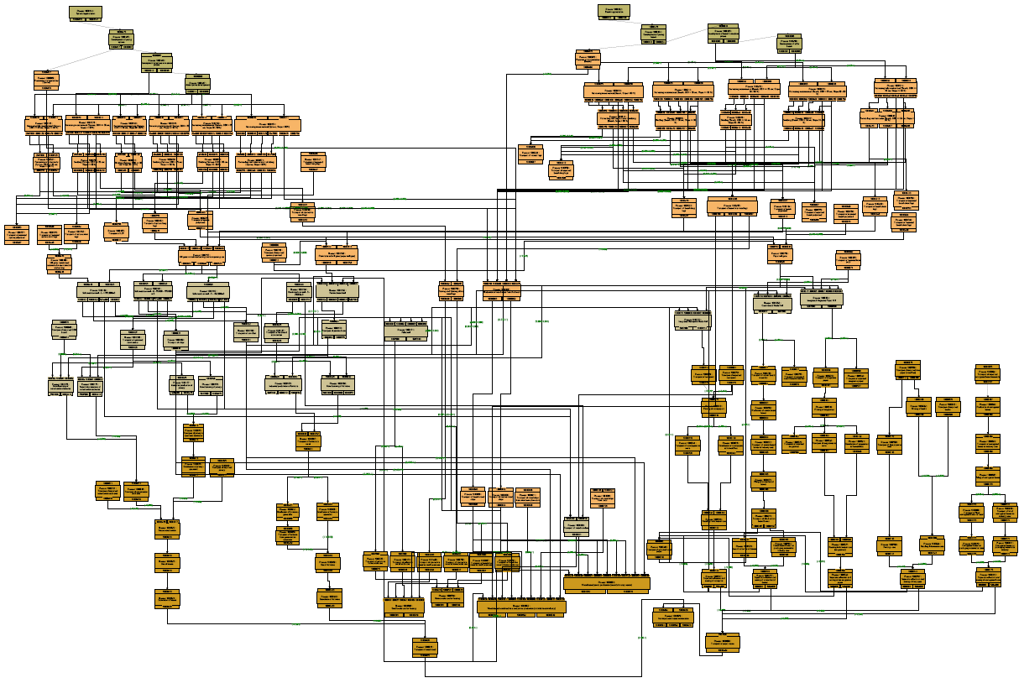
Case study Baden-Württemberg. A regional study

Slide 11
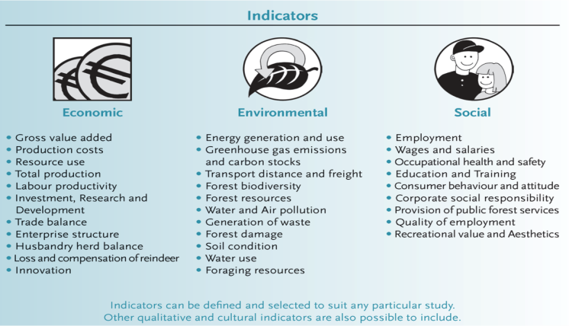
Indicators in ToSIA (so far)

Slide 12
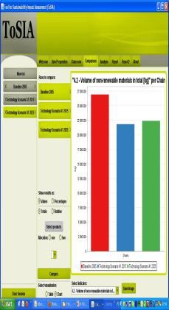

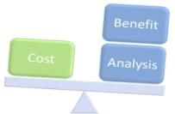
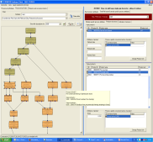
ToSIA tools
DATA ENTRY/IMPORT
Database
Data entry
Chain design
ToSIA
Calculation of material flow and indicator results for alternative chains
Aggregation and comparison of results
Evaluation
MCA
CBA
PA
Policy database
Wizard
Database Client
Results and Reports
Generating graphs
Writing reports
Export
Notes:
ToSIA 2.0: multilingual
TDC with Data entry wizard
MCA (single mode)
CBA (partially)
PA (conceptionally) with link to EFI Policy Portal
Indicators and
DCP with concepts about soft indicators (governance, VPAIM, cultural aspects)
Several cases in varying scale (plant – EU)
FWC and first non-FWCs (reindeer, oil)
ToSIA GIS link (conceptionally)
TMUG

Slide 13
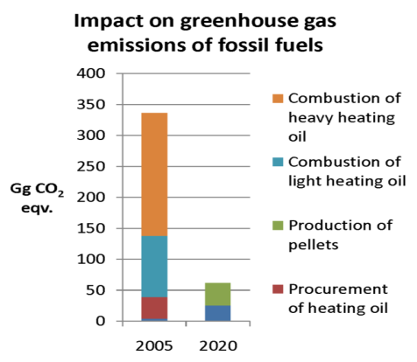

Sustainability impacts are compared between a baseline and scenarios
Environmental effects,
e.g. GHG, aggregated
by FWC Segment

Slide 14
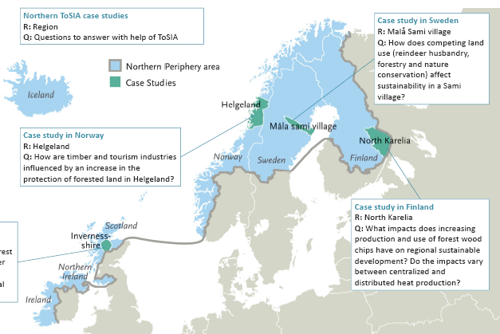
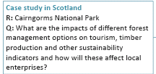
Examples of ToSIA applications:
Notes:
If slide ”cases” (25) is shown the NT cases are double.

Slide 15
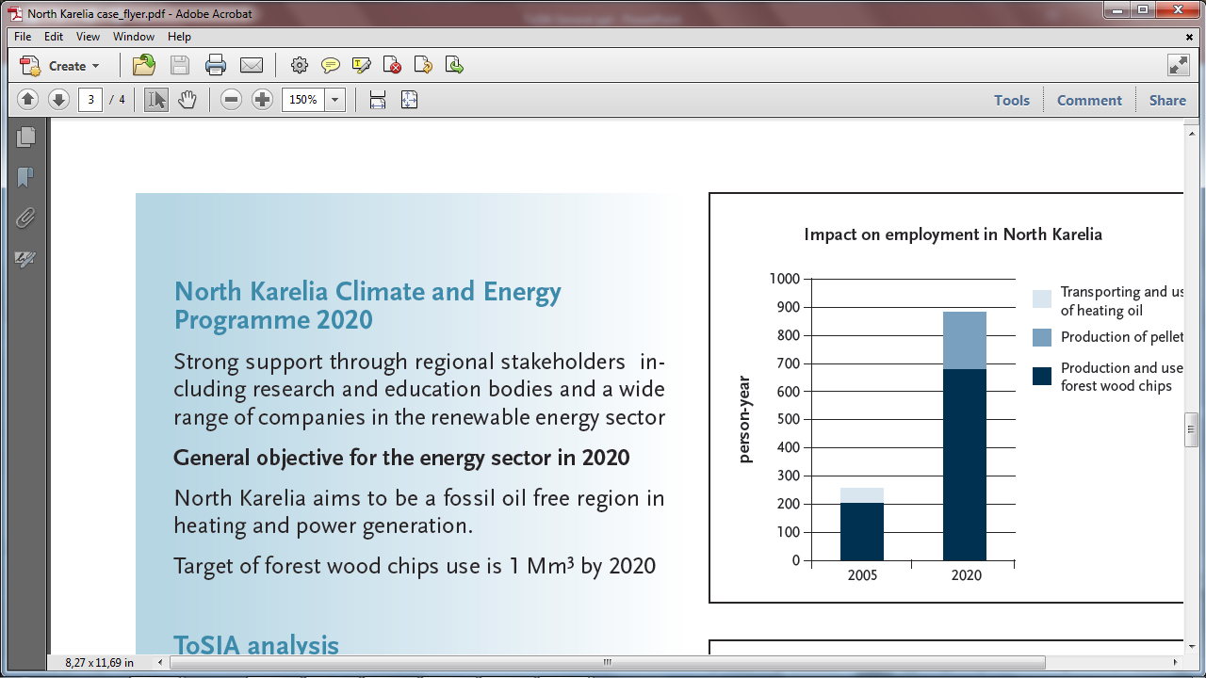
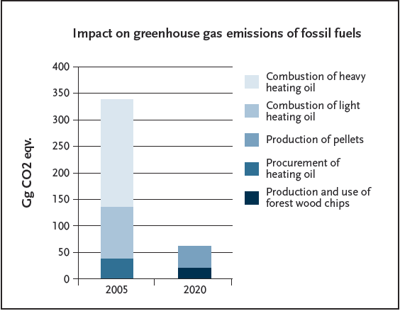
North Karelian Bioenergy study: replacing all fossil fuel for heating with forest energy

Slide 16
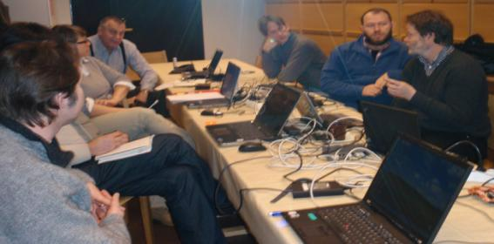
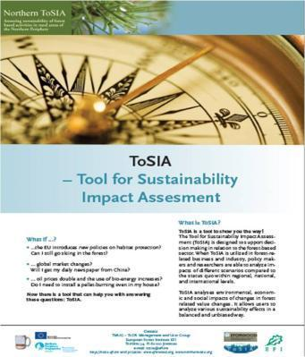

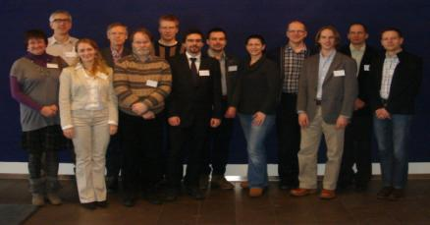
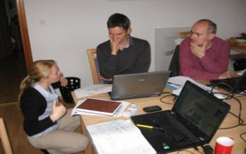
TMUG – ToSIA Management and user group

Slide 17
Did you get curious about ToSIA?
Please contact us
European Forest Institute (EFI):
Diana Tuomasjukka, Tommi Suominen, Marcus Lindner
Mail: diana.tuomasjukka@efi.int or tosia@efi.int
Web: http://tosia.efi.int
Notes:
17 institutes in TMUG

Slide 18
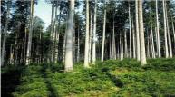
ToSIA perspectives and user benefits (1)
I will become a nice table...
System boundary: geographically defined forest area. Forest value chains are followed to consumers also outside of the forest resource region.
Possible user: Forest District Manager
Research Question: How to manage the forest resource to fit local market demand, while providing a range of other forest functions to society?
Benefits of using ToSIA: Transparent decision support tool that can be used for discussions with regional stakeholders
”forest-defined”

Slide 19



ToSIA perspectives and user benefits (2)
I used to live in Northern Sweden...
System boundary: geographically defined consumption of wood products. Wood supply chains are followed backwards to the origin of the forest resources.
Possible user: Policy Maker
Research Question: How would recycling incentives stimulating cascade use of wood products affect overall sustainability of wood product consumption?
Benefits of using ToSIA: Transparent decision support tool that can be used for discussions with industry and other stakeholders.
...in my earlier lives I had other carreers
”product-defined”

Slide 20
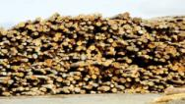

ToSIA perspectives and user benefits (3)
We grew up only 35 km from here...
System boundary: local mill or geographically defined industry branch. Wood supply chains and product value chains are followed backwards to the forest resources and forward to the end-of-life of the products.
Possible user: Company manager
Research Question: How does the establishment of a large new resource competitor affect transport distances? What are the overall sustainability impacts with and without adjustments in the mill capacity?
Benefits of using ToSIA: Decision support tool that can be used as transparent source of information for Corporate Social Responsibility Reporting.
I will be read
in downtown London!
”industry-defined”

Slide 21
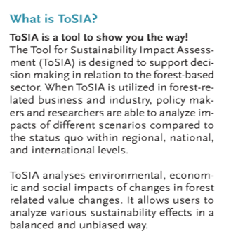
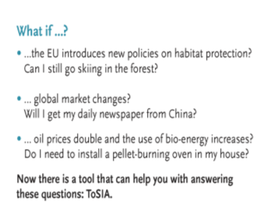
http://tosia.efi.int
Source: fotolia

Slide 22









ToSIA is a tool to answer WHAT IF?-questions.
WHAT IF:
Natura 2000 policy strengthens?
Consumption changes drastically?
Innovative technology kicks-off?
Bioenergy use triples?
?
?
Notes:
Can we show a better link to how ToSIA is handling scenarios?

Slide 23
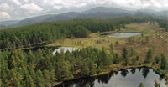
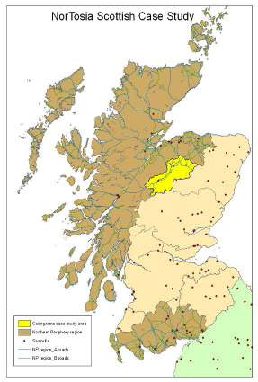
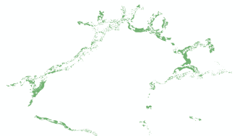
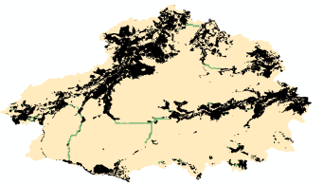
Northern ToSIA Scottish Case
Woodland Expansion Scenario:
Set by policy - but where to put that additional forest?
(suitability, tourism, timber production as criteria)
Here:
Timber production and Biodiversity Scenario: Where can that happen?
(suitability, tourism, timber production as criteria)
Here:
Multiple services of a National Park analysed jointly
with Forest Commission, Cairngorms National Park Authority, industry, and tourism
Case study lead: FR

