Slide 1

Environmental effects of integrating SRC into landscapes
Ioannis Dimitriou
Blas Mola-Yudego
Swedish University of Agricultural Sciences, Dep. of Crop Production Ecology
Joint workshop IEA Bioenergy – BiofuelNet: Landscape Management and Design for Bioenergy and the Bioeconomy
21/9/2016, Vancouver, BC, Canada

Slide 2
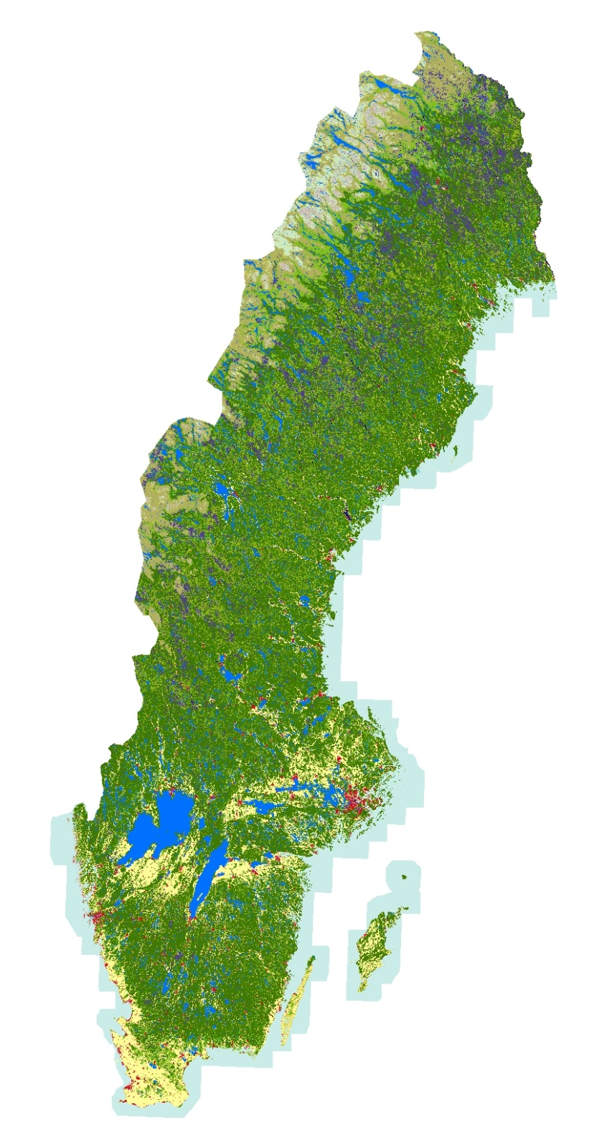

Slide 3
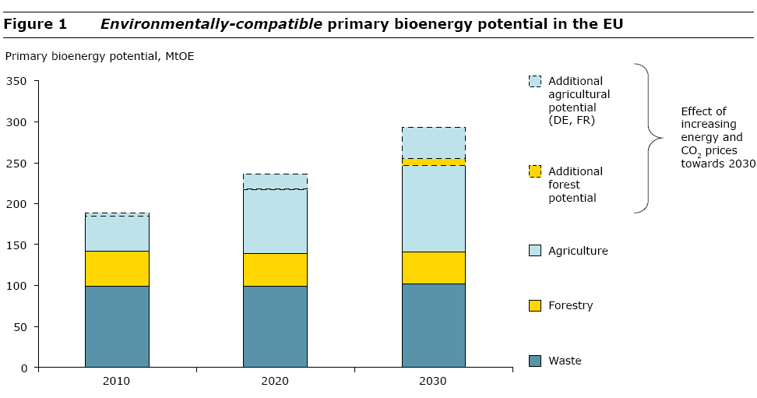
Source: EEA (European Environmental Agency) 2006.
How much bioenergy can Europe produce without harming the environment?
Notes:
50 mtoe = ca 2 Ej
Million Tons of Oil Equivalent

Slide 4
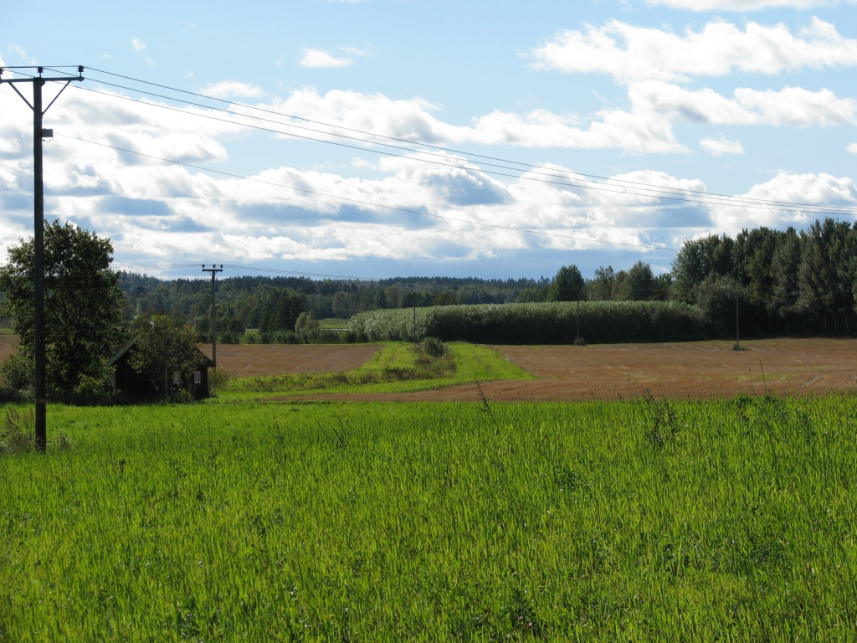
Notes:
Planted near natural deciduous forest

Slide 5
The Challenge
how to integrate new bioenergy feedstock production systems into agricultural landscapes in ways that promote environmental, social and economic sustainability of the agricultural production

Slide 6
How can we researchers help to succeed in this?

Slide 7
Notes:
Planted near natural deciduous forest

Slide 8
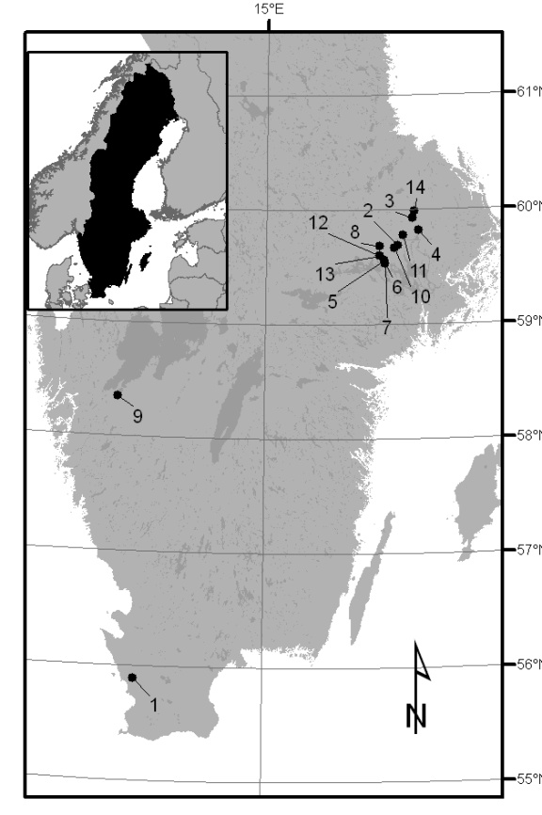

Slide 9
Relative differences between willow SRC plantations versus the reference. The values are the averages for all the locations of the different soil quality parameters investigated in topsoil (0-20 cm) and in subsoil (40-60 cm). Positive values represent higher observations of the studied parameter in the willow SRC plantations, in percentage (Dimitriou et al 2012, Bioenergy Research).

Slide 10
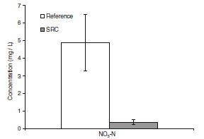
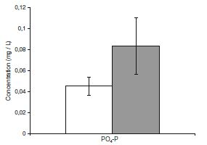
Nutrient leaching
Means, averages and standard errors of NO3–N and PO4–P concentrations in the groundwater of willow short rotation coppice (SRC) plantations and reference fields (Dimitriou et al, 2012 - Bioenergy Research)

Slide 11

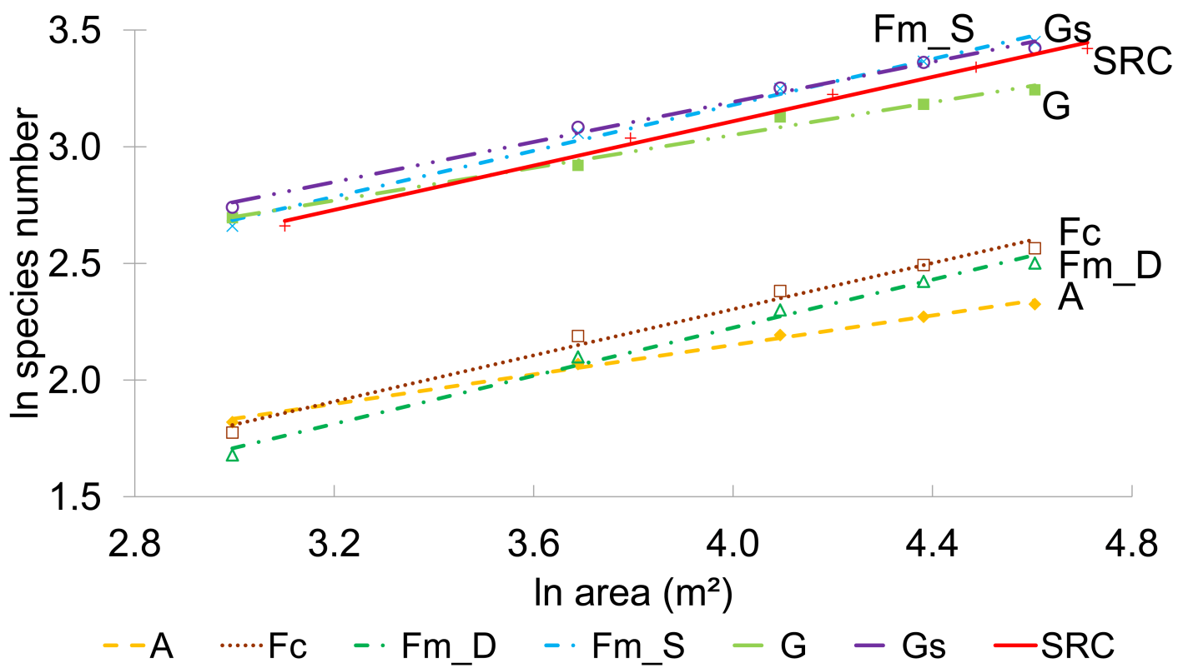
Results
Higher species number (ln) in SRC fields than in arable lands (A), German mixed forests (Fm_D) and coniferous forests (Fc)
Lower species number (ln) in SRC fields than in Swedish mixed forests (Fm_S)
Even small SRC areas had high species numbers
Baum S, Bolte A, Weih M (2012)

Slide 12
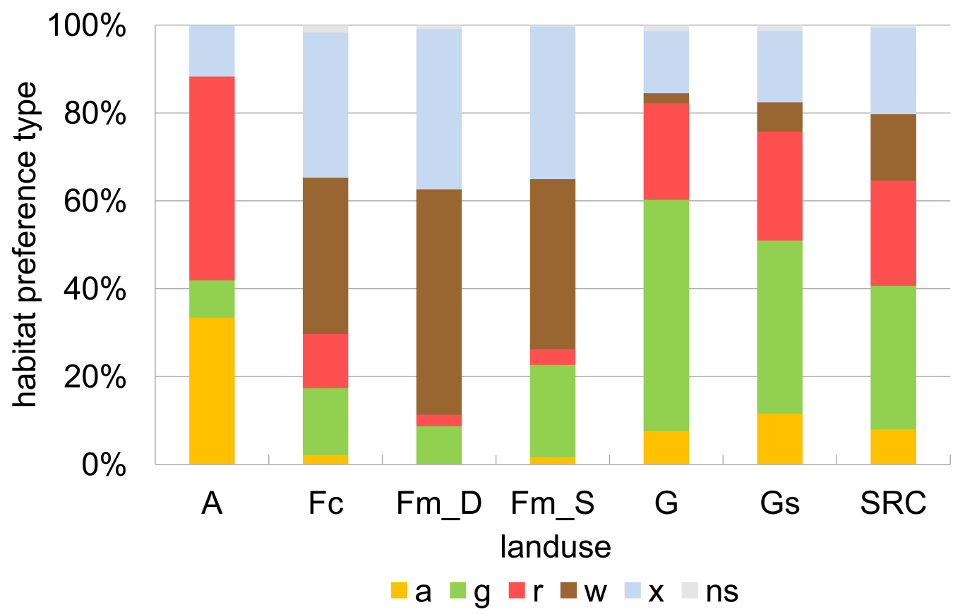
Results
Species habitat preferences were most balanced in SRC fields: 33% grassland, 24% ruderal and 15% woodland species
Other land uses: more pronounced focus on one or two habitat preference types
Similarity highest to grasslands
a=arable field, g=grassland, r=ruderal, w=woodland species, x=indifferent, ns: not stated.
Based on coarse habitat preferences according to Ellenberg et al. (2001)
Baum S, Bolte A, Weih M (2012a)

Slide 13
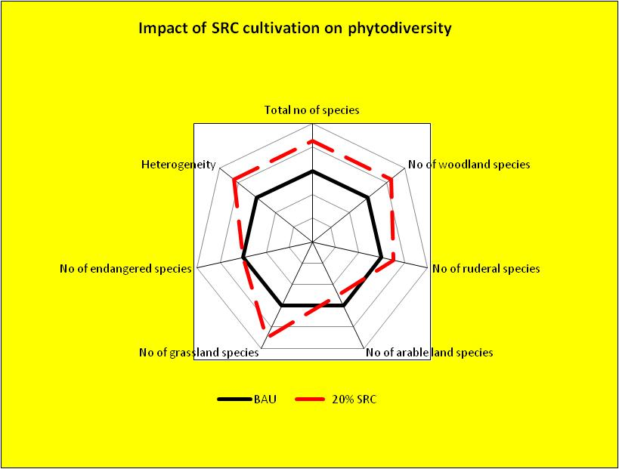
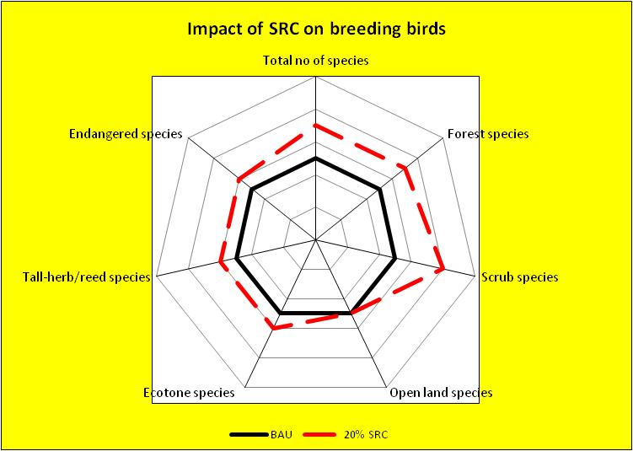
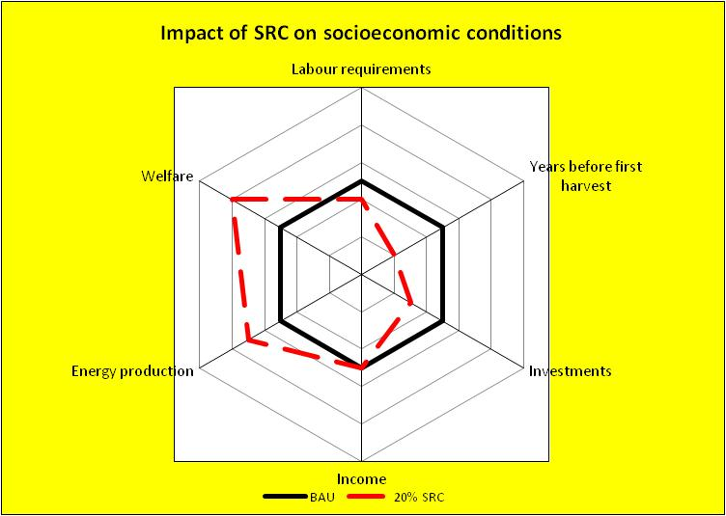
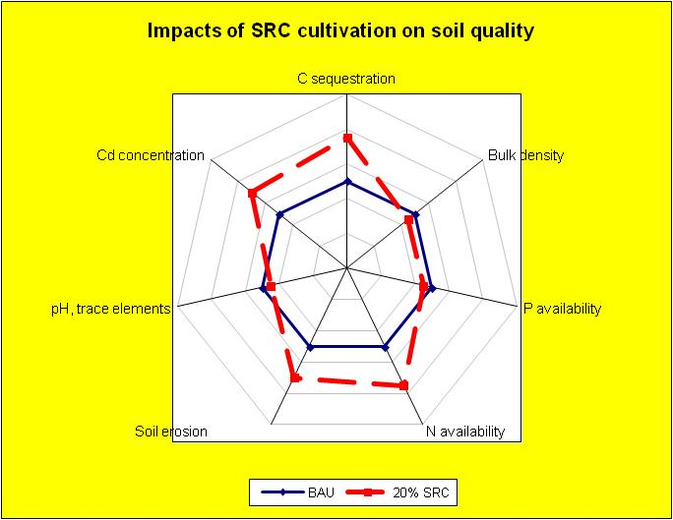
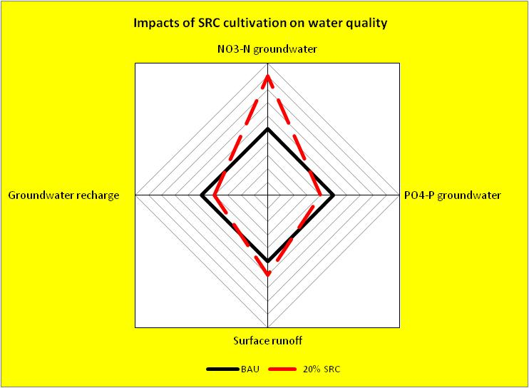
In Langeveld et al., 2012
(Bioenergy Research)

Slide 17
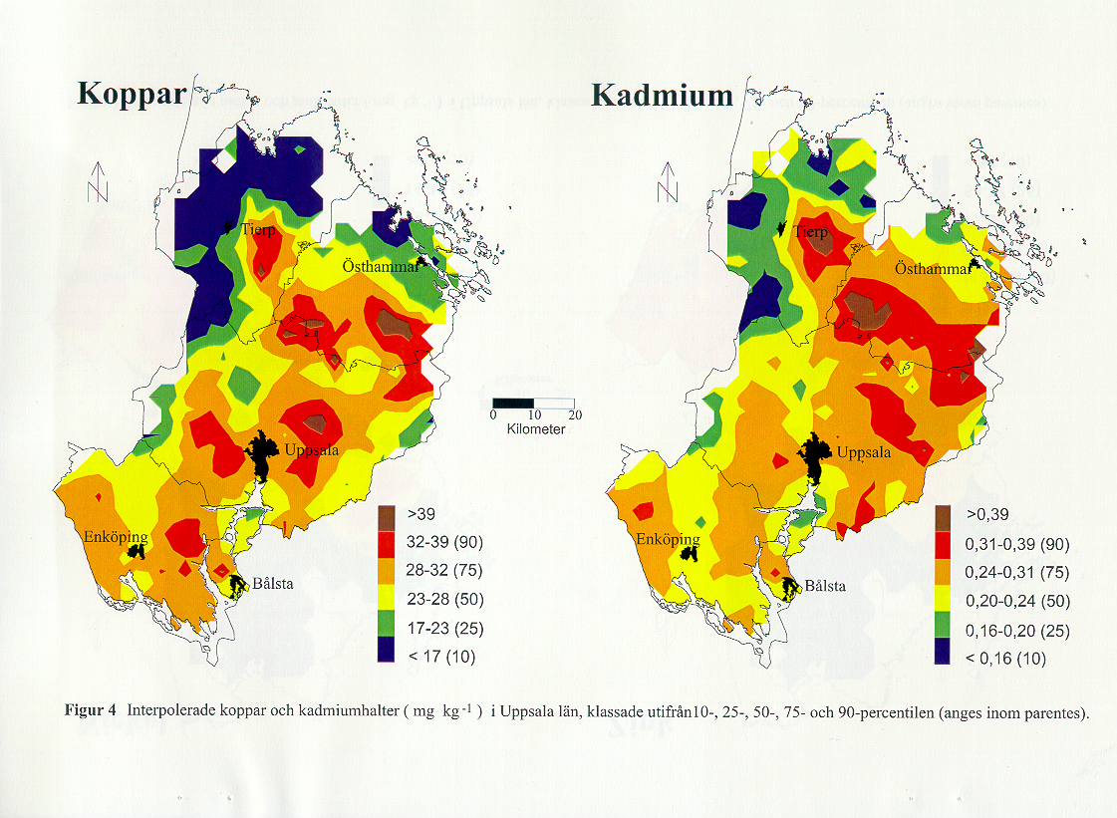


Slide 18
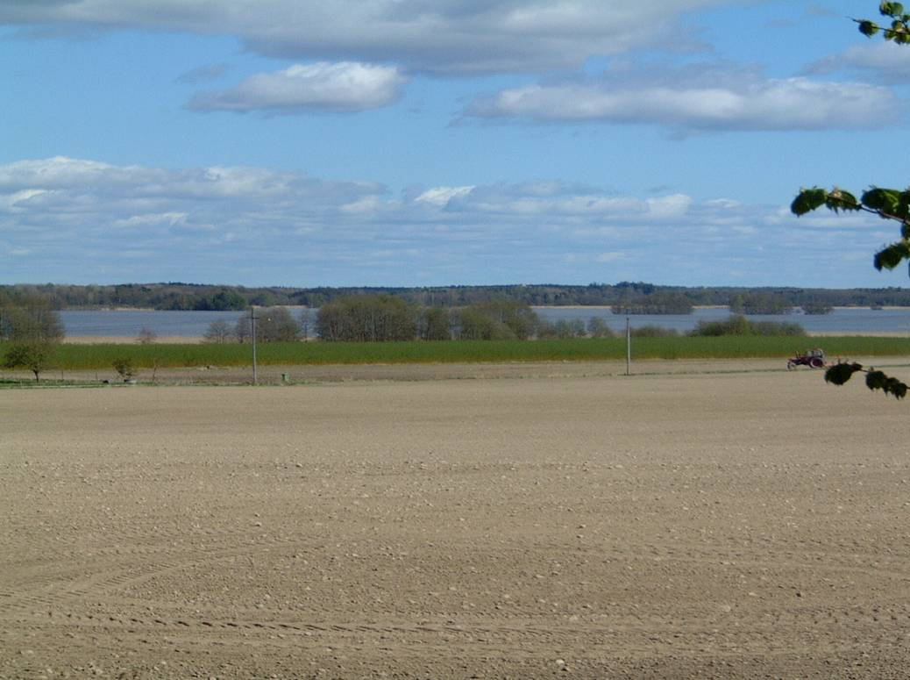

Riparian buffer zones and bioenergy production
Dr. Ioannis Dimitriou, SLU (Swedish University of Agricultural Sciences), Dep. of Crop Production Ecology.
PhD course ”Production of Biomass for Energy – quantity and quality aspects”, Ecology building, Uppsala, Sweden.

Slide 19
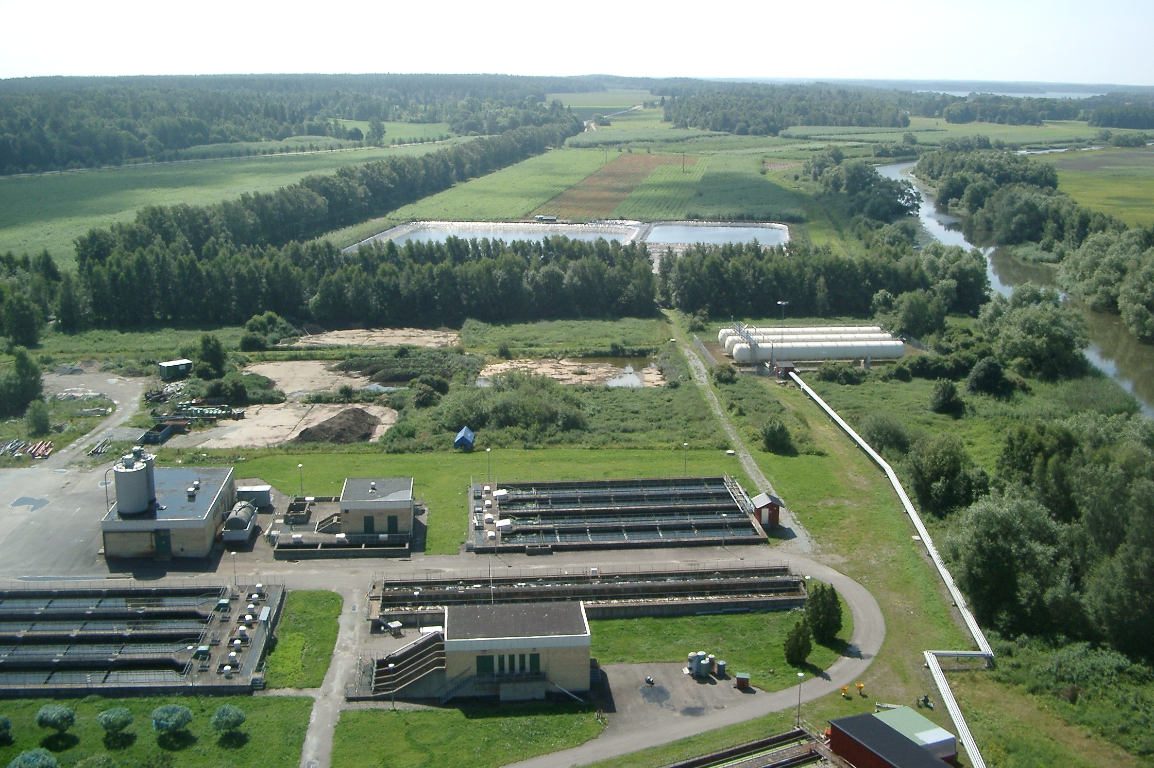
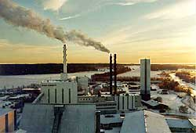
Wastewater treatment in Enköping
SRWC plantations (76 ha)
Wastewater storage ponds
Wastewater treatment
plant (20000 pe)

Slide 20
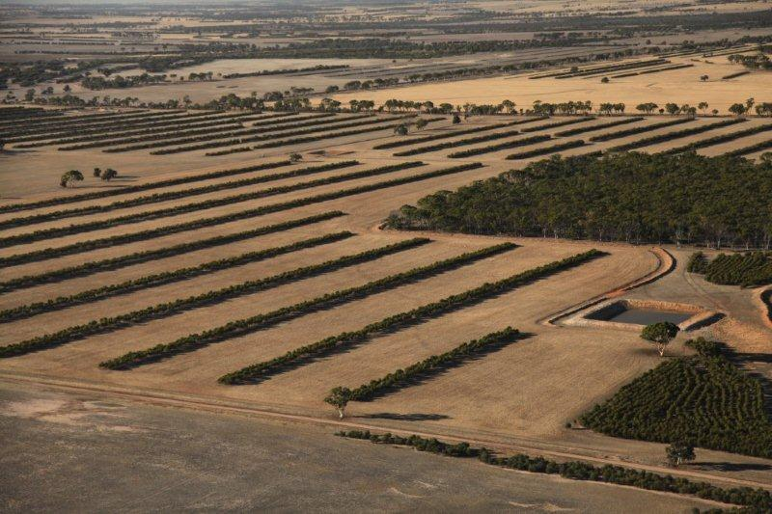
Soil salinization management
Oil Mallee, Australia – Picture: John McGrath
Trees and shrubs can be used to address soil salinity by reducing groundwater recharge, either by using water in the root zone and reducing ‘leakage’ to deeper aquifers; or by reducing saline or potentially saline groundwater levels (make them deeper beneath the ground surface) through roots directly accessing the water table and increasing discharge.

Slide 21
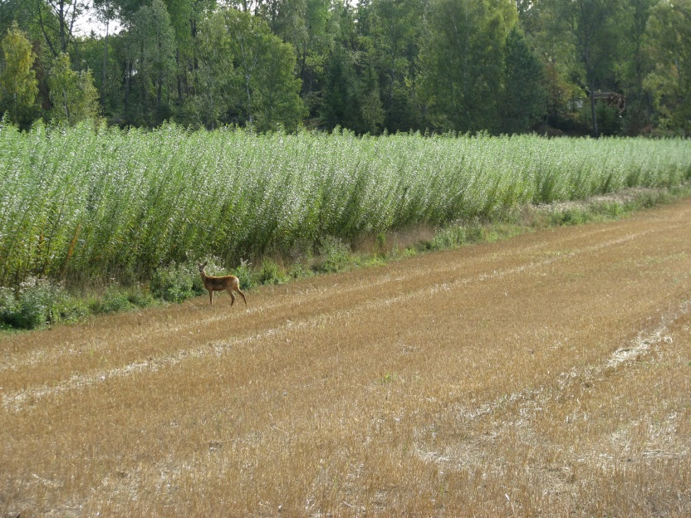
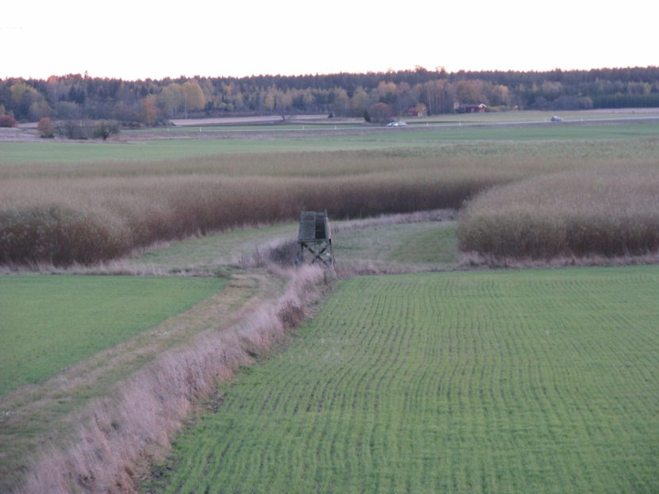
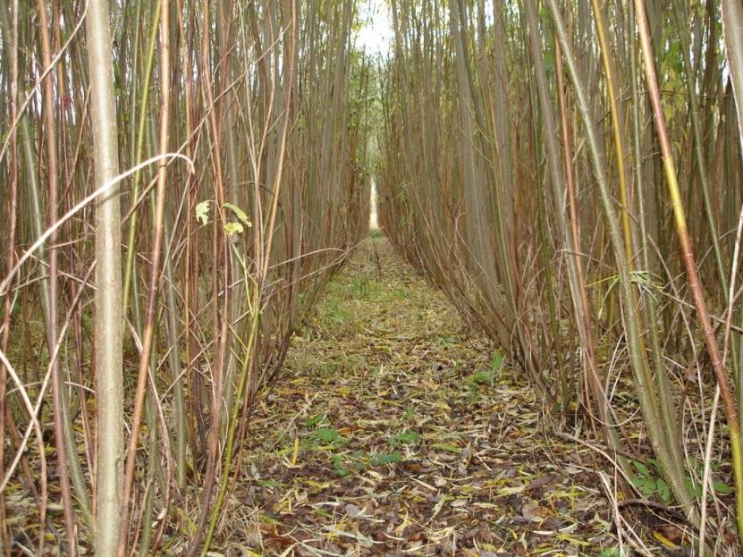
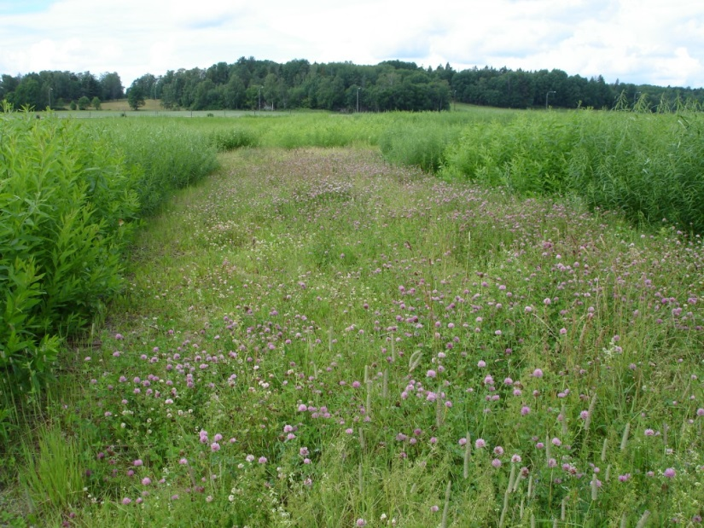
Biodiversity increase?

Slide 22
Suitability areas - Examples

Slide 23
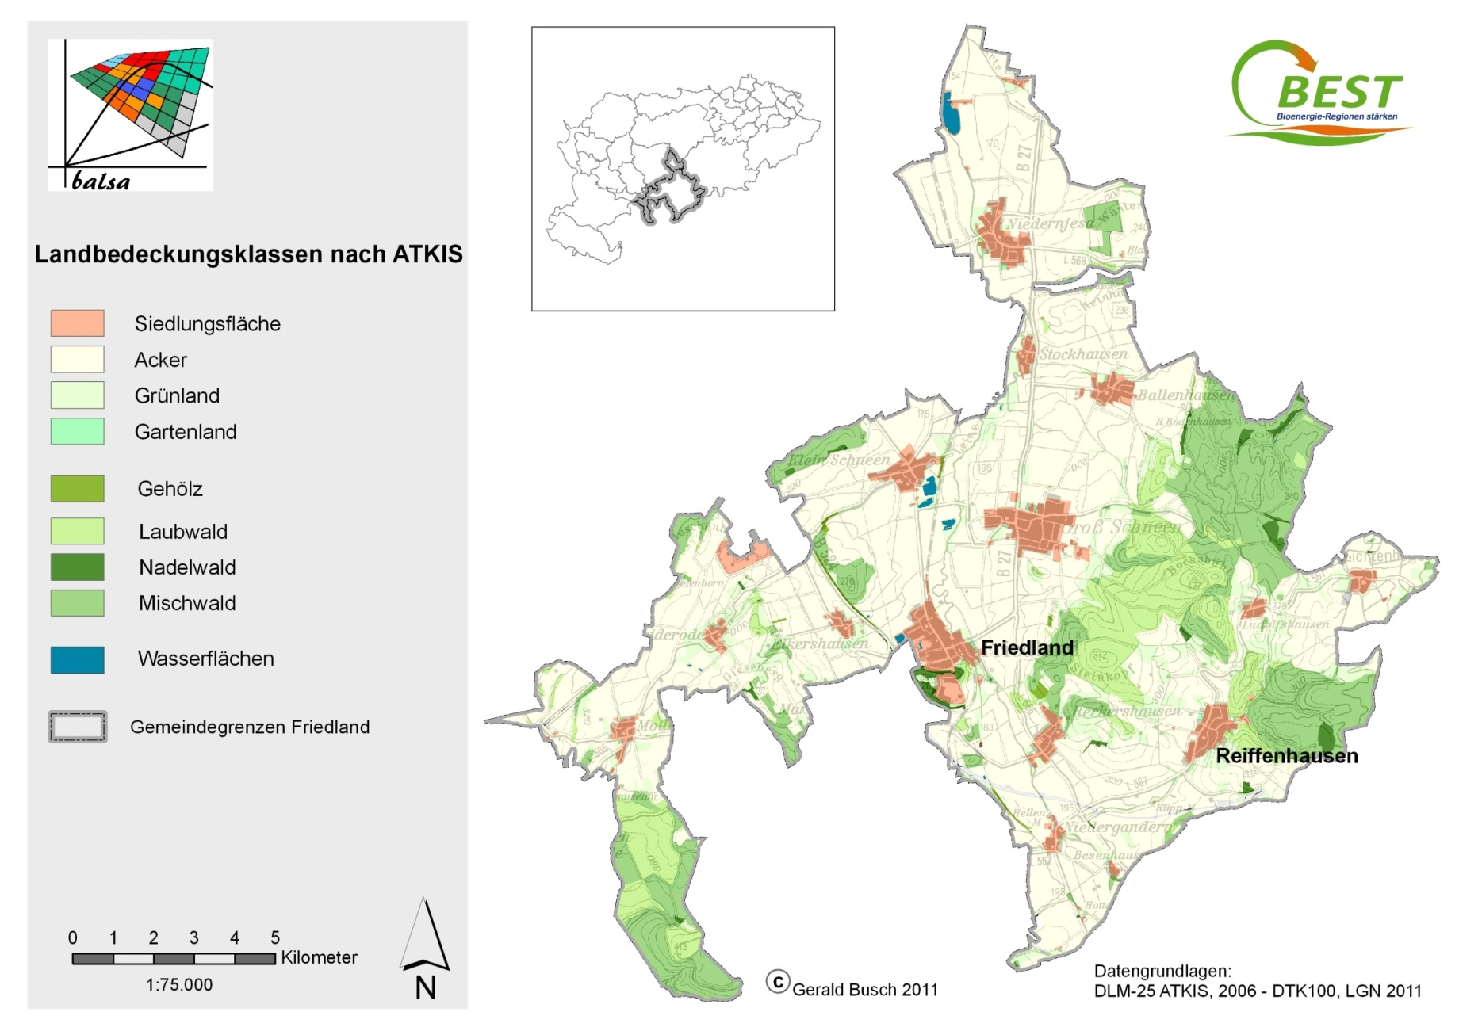
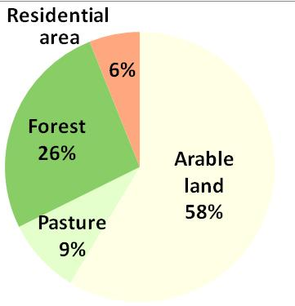
Municipality of Friedland, DE – erosion, leaching
Land cover classes
residential area
arable land
pasture
Arable land
woods
dec. forest
conf. forest
mix. forest
water
municipality border
Case study: G Busch, BALSA

Slide 24
„High disposition to water erosion“
Combination of erosion protection
and enhancing(bio)diversity
Reduce increasing
erosion risk due to
maize
Buffer strips could
reduce sediment
load
Case study: G Busch, BALSA

Slide 25
… zoom in
„High disposition
to water erosion“
combining groundwater protection
and erosion protection
Case study: G Busch, BALSA

Slide 26
We will focus on:
Economy of different lignocellulosic crops
Different management options and their impact on environment
Evaluation and simulation of a portfolio of species and management alternatives (planting strategy, fertilization actions, cutting cycle length, etc.) and a set of land-use scenarios - for similar zones
Resulting management schemes and land-use scenarios will be assessed considering each of the main environmental services defined for each zone (providing dimensions, whether biomass production, water quality improvement etc)
The land-use alternatives will define a Pareto frontier

Slide 27
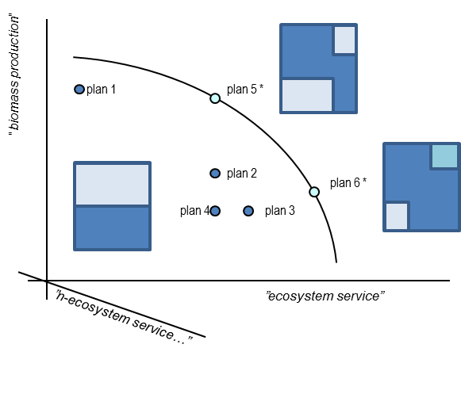
Pareto frontier
Figure. Simplified illustration of pareto frontier efficiency between two hypothetical alternative services (biomass production for energy and water quality, bi-dimensional decision map) and 5 integrated land use and management schemes configuration alternatives. Plan 5 and 6 show pareto-efficiency. There can be additional service dimensions and a large number of management alternatives to be analysed. Real examples can be found in e.g. Lautenbach et al, 2013, Borges et al, 2014.
Effective trade-offs between the different alternatives and objectives will be found
A set of compatible trade-offs alternatives will be consulted by the different stakeholders and decision makers
In the end, a double assessment will be delivered: a quantitative analysis resulting in a set of efficient alternatives for each zone, and a qualitative analysis resulting in an assessment of each of the selected alternatives by experts and stakeholders.

Slide 28
